Slide 1
low-dimensional quantum magnetism: superdiffusion breakdown in spin ladders and quantum spin liquids on the triangular lattice
Kevin Wang
UC Berkeley Qualifying Exam

Slide 2
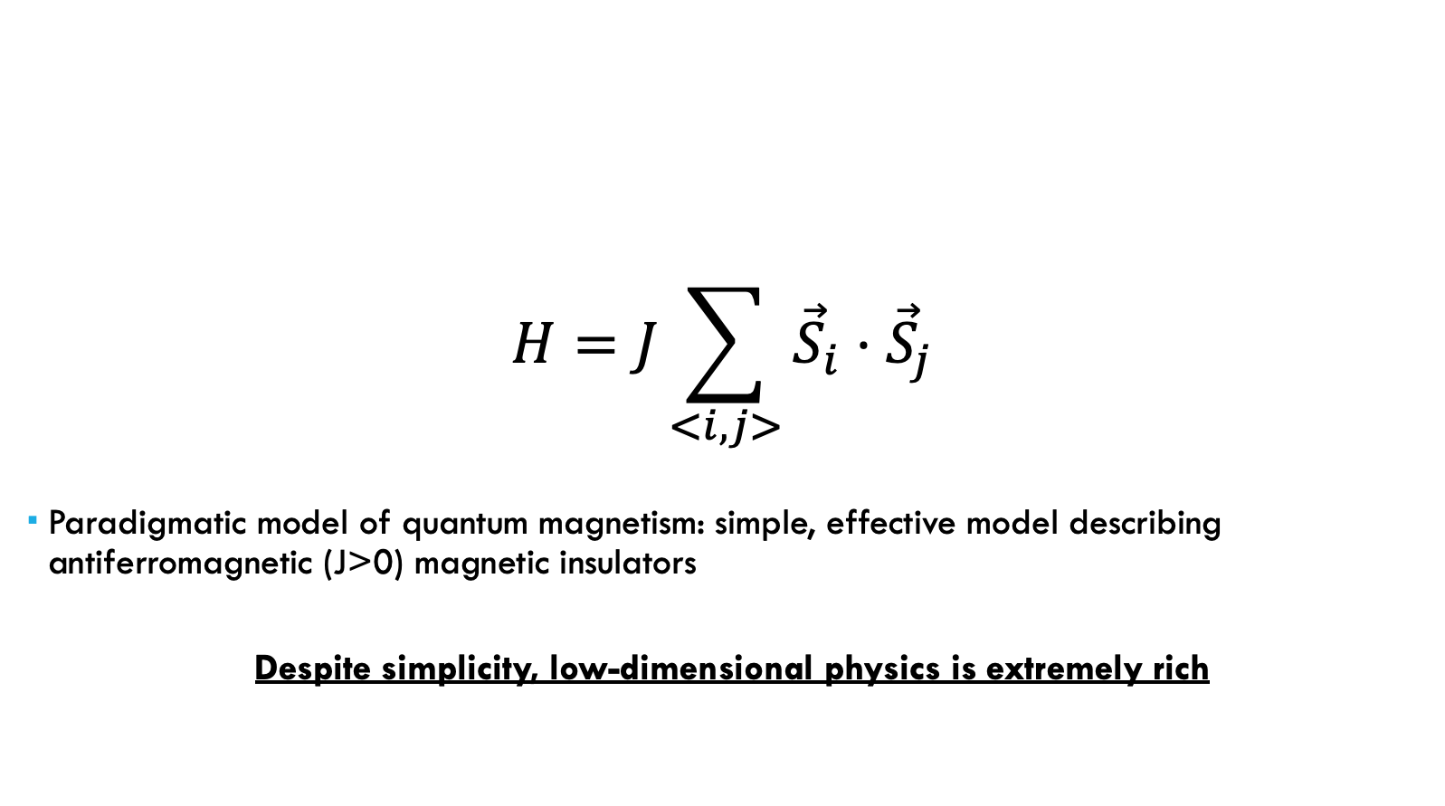
Quantum Heisenberg Model
$$H=J\sum_{<i,j>}{{\vec{S}}_{i}}⋅{\vec{S}}_{j}$$
Paradigmatic model of quantum magnetism: simple, effective model describing antiferromagnetic (J>0) magnetic insulators
Despite simplicity, low-dimensional physics is extremely rich

Slide 3
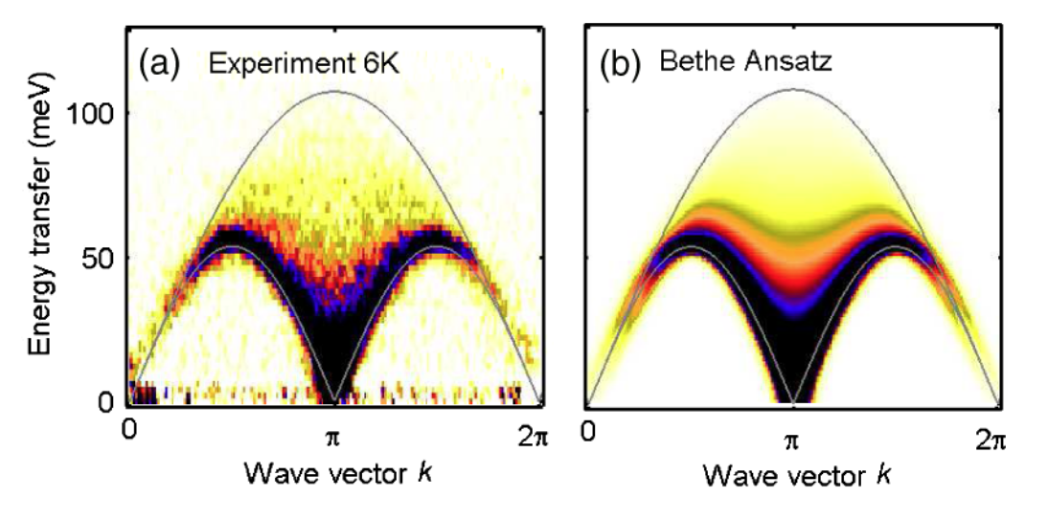
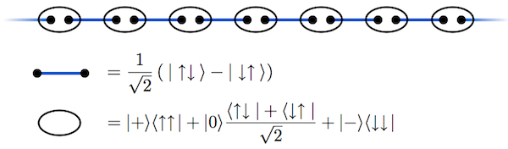
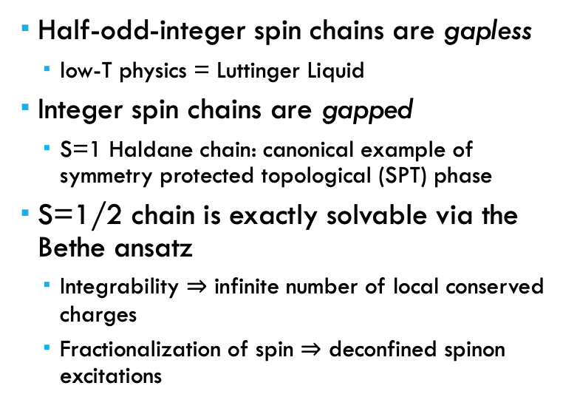
Quantum Heisenberg Model
One dimension (1D)
Half-odd-integer spin chains are gapless
low-T physics = Luttinger Liquid
Integer spin chains are gapped
S=1 Haldane chain: canonical example of symmetry protected topological (SPT) phase
S=1/2 chain is exactly solvable via the Bethe ansatz
Integrability $⇒$ infinite number of local conserved charges
Fractionalization of spin $⇒$ deconfined spinon excitations
Lake et al., PRL (2013)
“AKLT Model”, Wikipedia

Slide 4
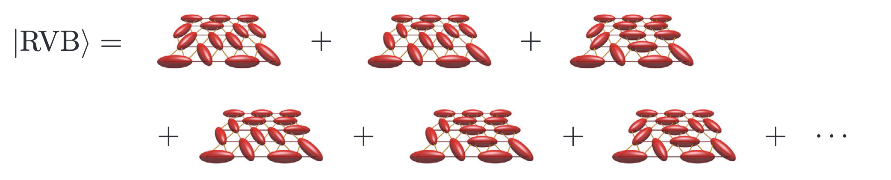
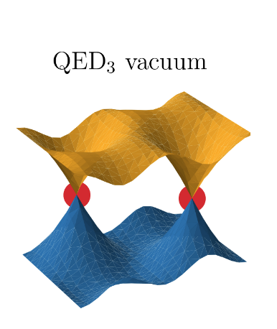
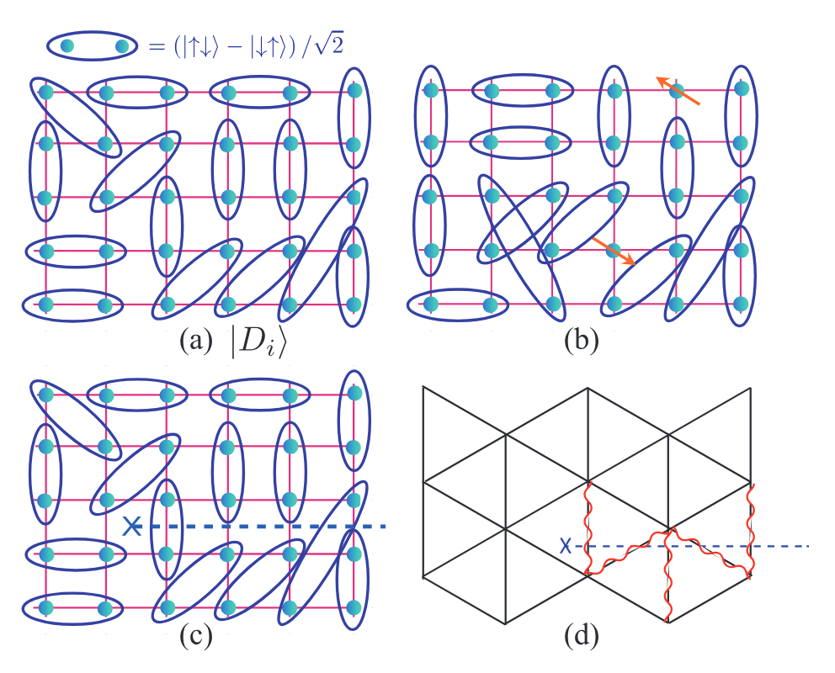
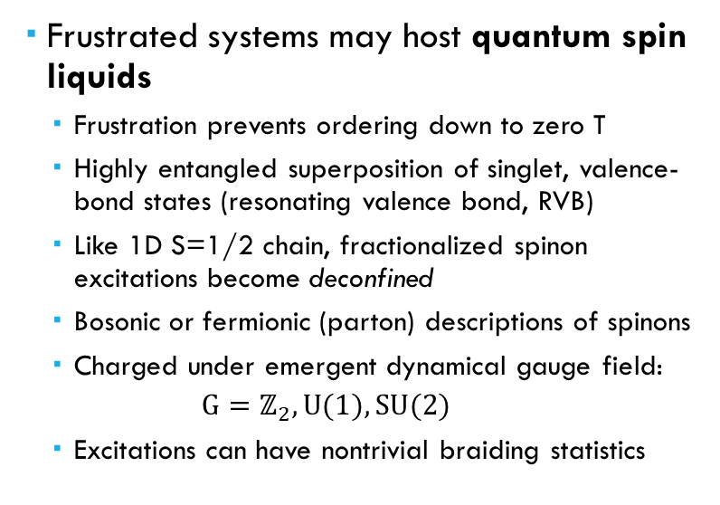
Quantum Heisenberg Model
Two dimensions (2D)
Frustrated systems may host quantum spin liquids
Frustration prevents ordering down to zero T
Highly entangled superposition of singlet, valence-bond states (resonating valence bond, RVB)
Like 1D S=1/2 chain, fractionalized spinon excitations become deconfined
Bosonic or fermionic (parton) descriptions of spinons
Charged under emergent dynamical gauge field:
$$G=ℤ_{2}, U(1), SU(2)$$
Excitations can have nontrivial braiding statistics
Savary and Balents, Rep. Prog. Phys. (2017)
“Quantum Phases of Matter” Subir Sachdev (2023)
Wietek et al., PRX (2024)

Slide 5
Quantum Heisenberg Model
Part I: Breakdown of superdiffusion in S=1/2 Heisenberg spin ladders and more…
Part II: Quantum spin liquid phase in J1-J2 model on triangular lattice

Slide 6
Quantum Heisenberg Model
Part I: Breakdown of superdiffusion in S=1/2 Heisenberg spin ladders and more…
Part II: Quantum spin liquid phase in J1-J2 model on triangular lattice

Slide 7
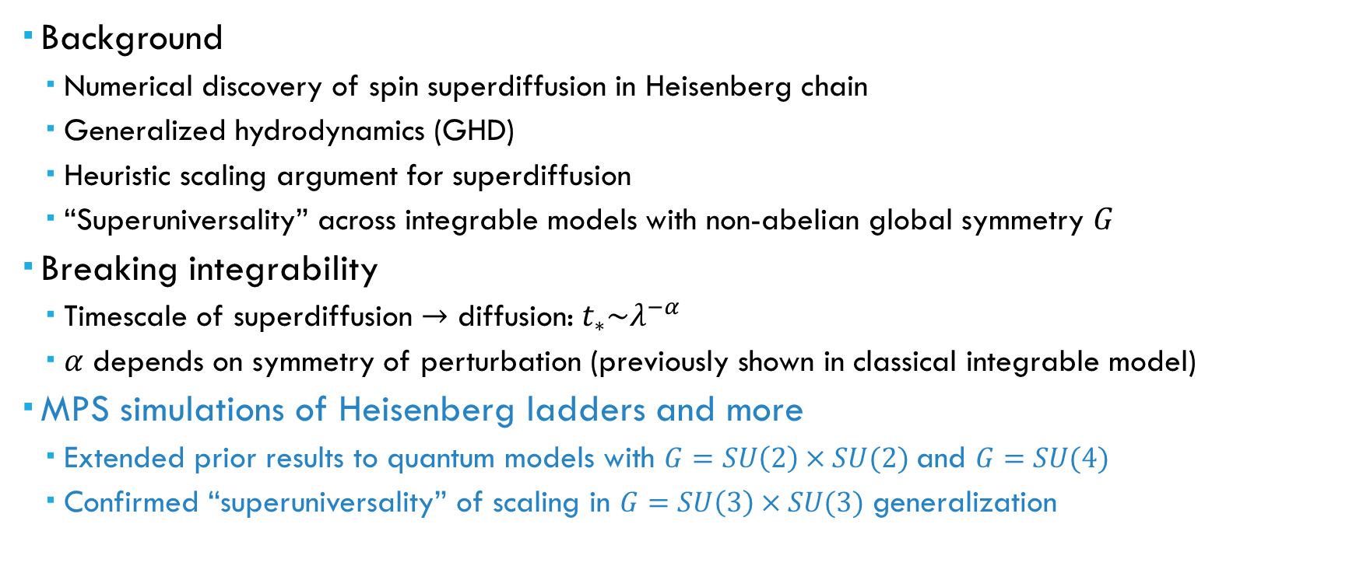
Outline of Part i
Background
Numerical discovery of spin superdiffusion in Heisenberg chain
Generalized hydrodynamics (GHD)
Heuristic scaling argument for superdiffusion
“Superuniversality” across integrable models with non-abelian global symmetry $G$
Breaking integrability
Timescale of superdiffusion $→$ diffusion: $t_{∗}\sim λ^{−α}$
$α$ depends on symmetry of perturbation (previously shown in classical integrable model)
MPS simulations of Heisenberg ladders and more
Extended prior results to quantum models with $G=SU\left(2\right)×SU(2)$ and $G=SU(4)$
Confirmed “superuniversality” of scaling in $G=SU\left(3\right)×SU(3)$ generalization

Slide 8
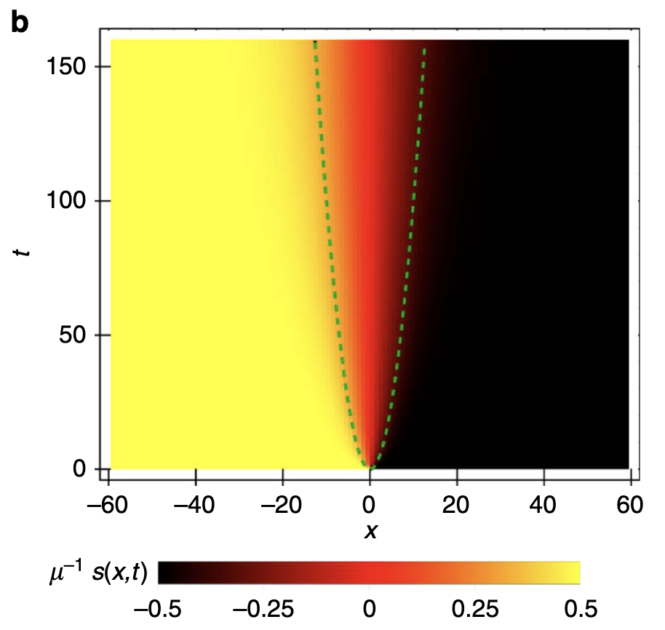
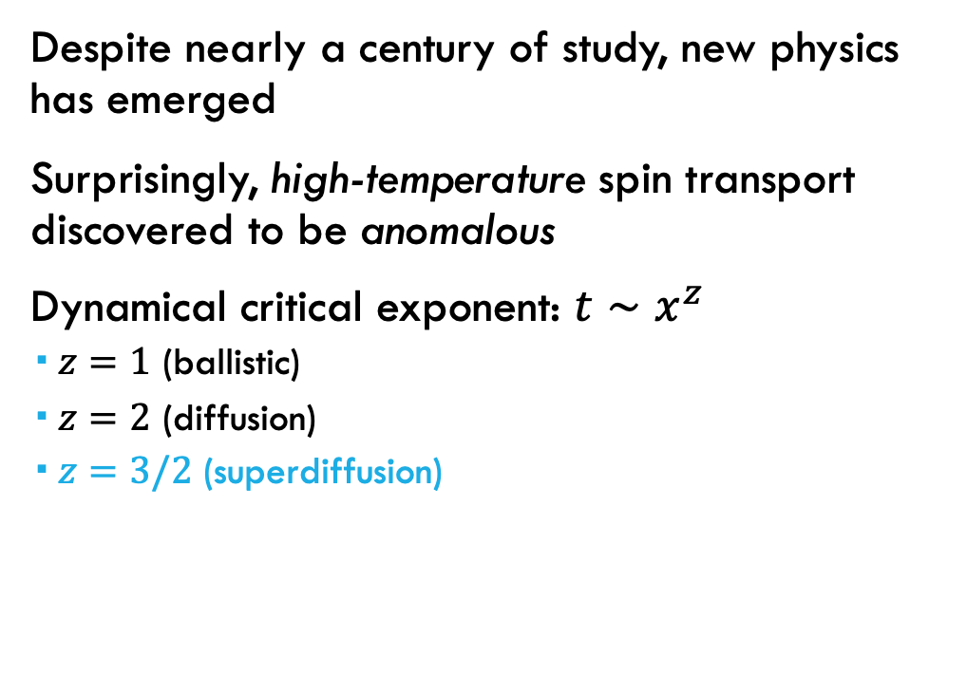

S=1/2 Heisenberg Chain: Anomalous Spin Transport
Despite nearly a century of study, new physics has emerged
Surprisingly, high-temperature spin transport discovered to be anomalous
Dynamical critical exponent: $t∼x^{z}$
$z=1$ (ballistic)
$z=2$ (diffusion)
$z=3/2$ (superdiffusion)
$$x \sim t^{2/3}$$
Ljubotina, Žnidarič & Prosen, Nat. Commun. (2017)

Slide 9
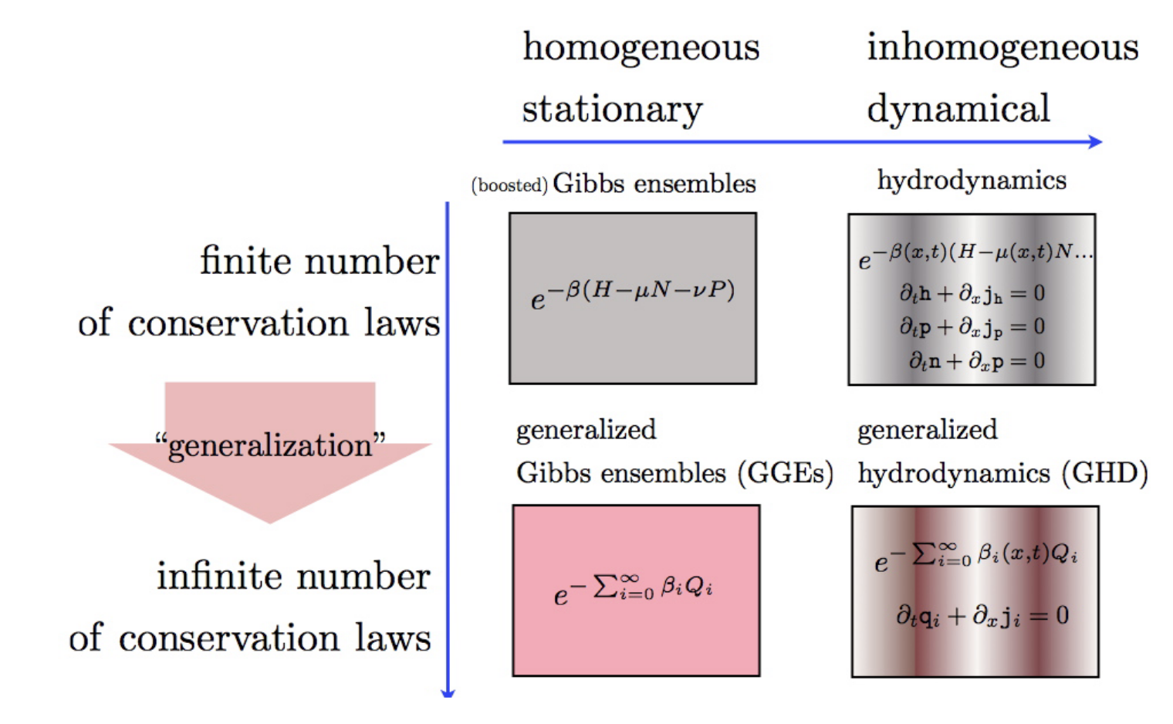
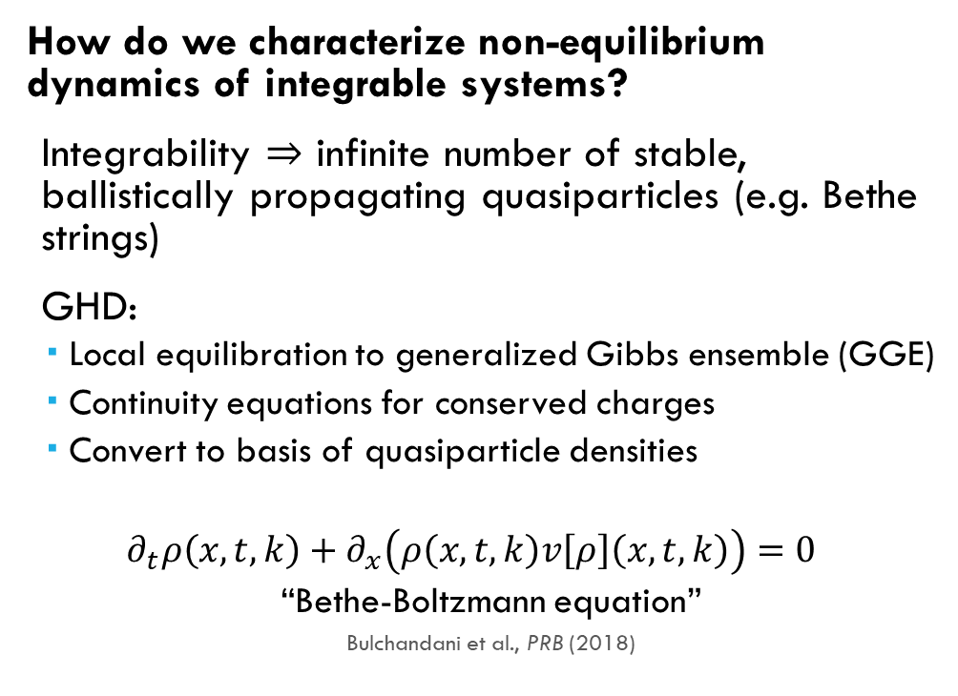
Generalized Hydrodynamics (GHD)
How do we characterize non-equilibrium dynamics of integrable systems?
Integrability $⇒$ infinite number of stable, ballistically propagating quasiparticles (e.g. Bethe strings)
GHD:
Local equilibration to generalized Gibbs ensemble (GGE)
Continuity equations for conserved charges
Convert to basis of quasiparticle densities
$$∂_{t}ρ\left(x,t,k\right)+∂_{x}\left(ρ\left(x,t,k\right)v\left[ρ\right]\left(x,t,k\right)\right)=0$$
“Bethe-Boltzmann equation”
Bulchandani et al., PRB (2018)
Doyon, SciPost Phys. Lect. Notes (2020)
Notes:
Infinite conservation laws, failure to thermalize

Slide 10
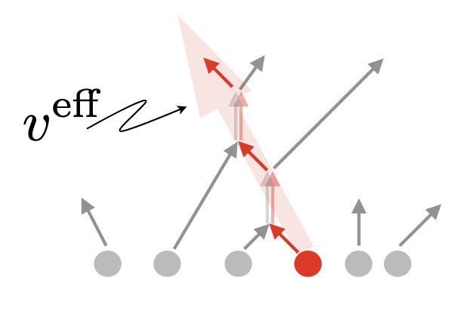
Generalized Hydrodynamics (GHD)
Intuitive picture: quasiparticles travel ballistically with effective velocity and charge dressed (renormalized) by elastic collisions with other quasiparticles
Doyon, SciPost Phys. Lect. Notes (2020)
Notes:
Infinite conservation laws, failure to thermalize

Slide 11
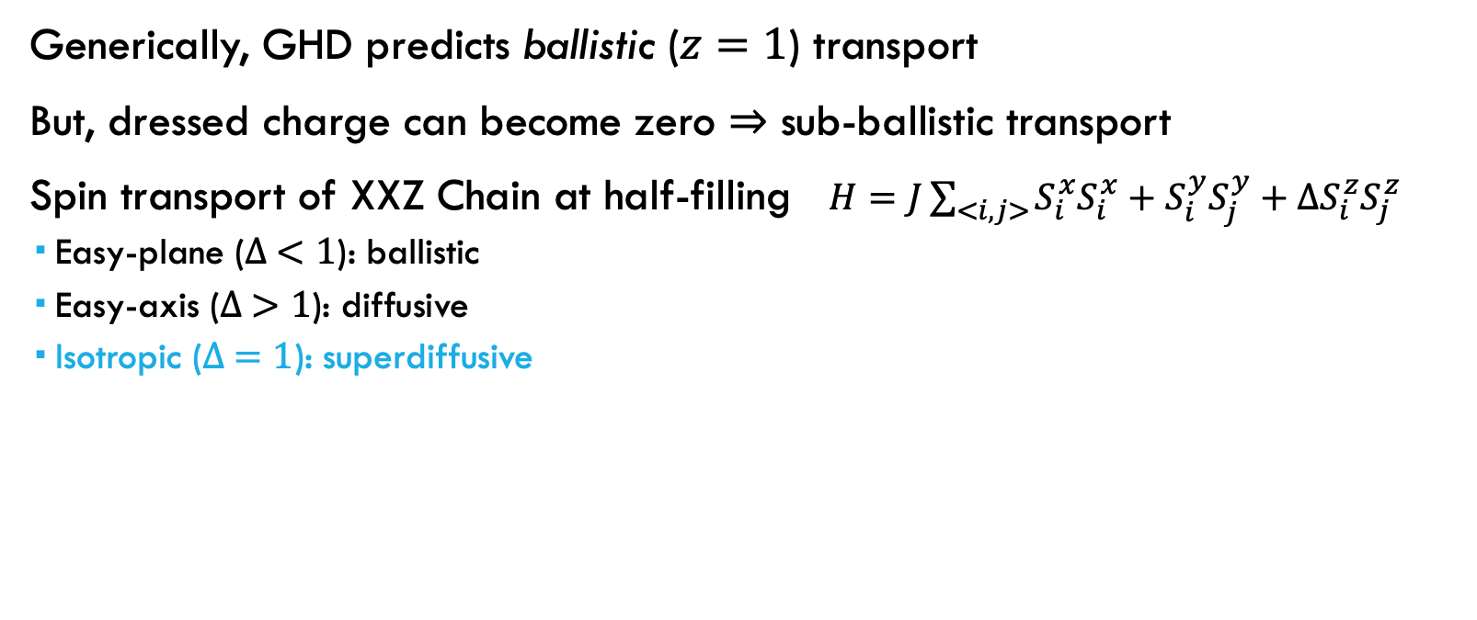
S=1/2 Heisenberg Chain: Anomalous Spin Transport
Generically, GHD predicts ballistic ($z=1$) transport
But, dressed charge can become zero $⇒$ sub-ballistic transport
Spin transport of XXZ Chain at half-filling $H=J\sum_{<i,j>}{S_{i}^{x}S_{i}^{x}+S_{i}^{y}S_{j}^{y}+ΔS_{i}^{z}S_{j}^{z}}$
Easy-plane ($∆ <1$): ballistic
Easy-axis ($∆ >1$): diffusive
Isotropic ($∆ =1$): superdiffusive

Slide 12
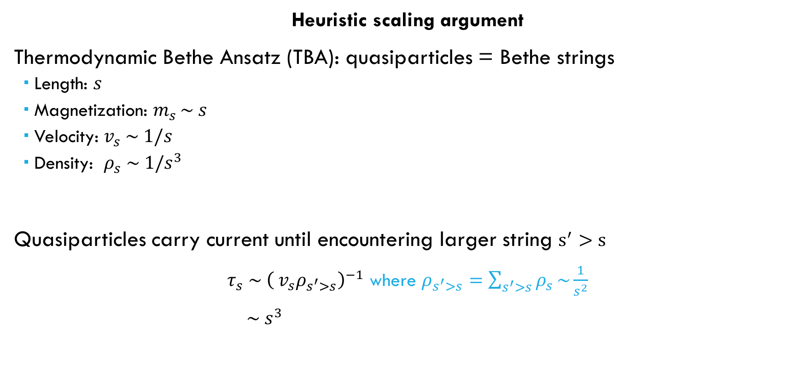
Why superdiffusion?
Heuristic scaling argument
Thermodynamic Bethe Ansatz (TBA): quasiparticles = Bethe strings
Length: $s$
Magnetization: $m_{s }\sim s$
Velocity: $v_{s} \sim 1/s$
Density: $ρ_{s} \sim 1/s^{3}$
Quasiparticles carry current until encountering larger string $s^{′}>s$
$τ_{s} \sim {\left({ v}_{s}ρ_{s^{′}>s}\right)}^{−1}$ where $ρ_{s^{′}>s}=\sum_{s^{′}>s}{ρ_{s}}\sim \frac{1}{s^{2}}$
$\sim s^{3}$

Slide 13
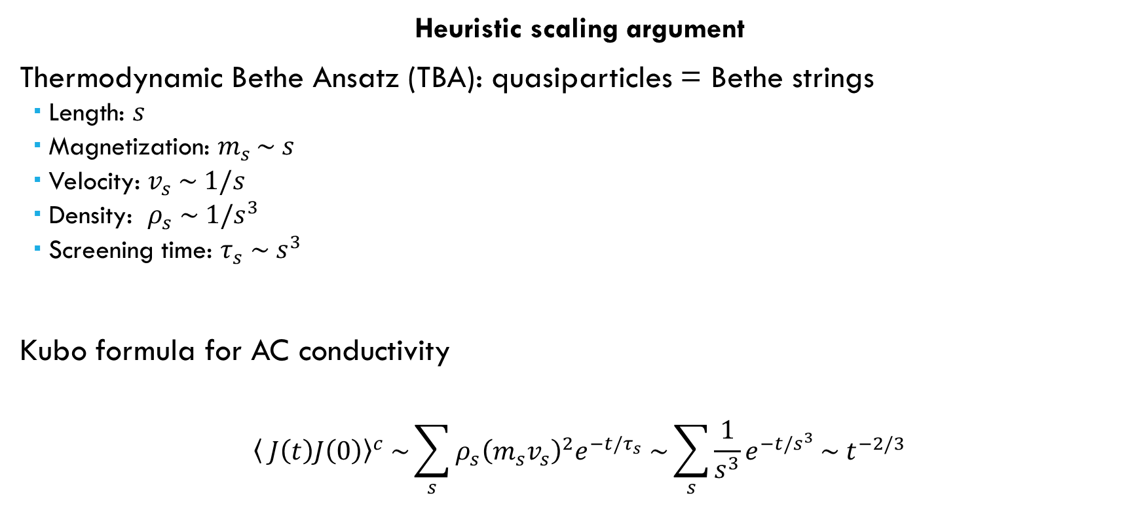
Why superdiffusion?
Heuristic scaling argument
Thermodynamic Bethe Ansatz (TBA): quasiparticles = Bethe strings
Length: $s$
Magnetization: $m_{s }\sim s$
Velocity: $v_{s} \sim 1/s$
Density: $ρ_{s} \sim 1/s^{3}$
Screening time: $τ_{s} \sim s^{3}$
Kubo formula for AC conductivity
$${\left\langle J\left(t\right)J\left(0\right)\right\rangle }^{c} \sim \sum_{s}{ρ_{s}{\left(m_{s}v_{s}\right)}^{2}e^{−t/τ_{s}} \sim \sum_{s}{\frac{1}{s^{3}}e^{−t/s^{3}}}\sim { t}^{−2/3}}$$

Slide 14
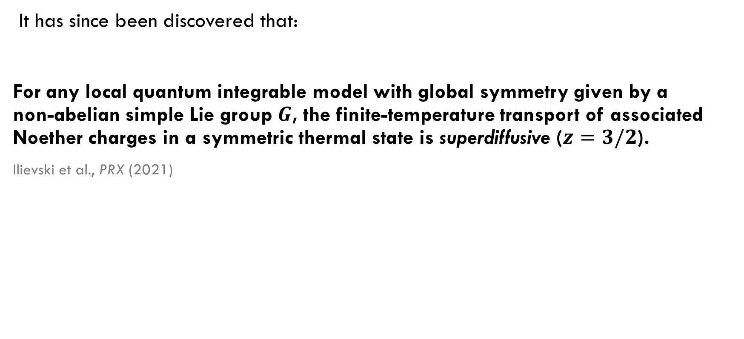
“Superuniversality” of superdiffusion
It has since been discovered that:
For any local quantum integrable model with global symmetry given by a non-abelian simple Lie group $G$, the finite-temperature transport of associated Noether charges in a symmetric thermal state is superdiffusive ($z=3/2$).
Ilievski et al., PRX (2021)

Slide 15
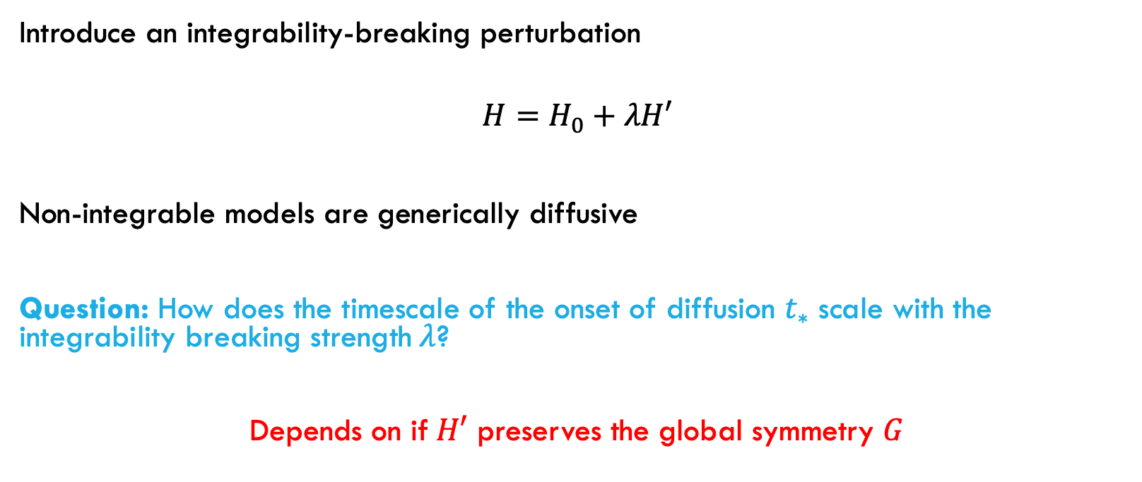
Breaking integrability
Introduce an integrability-breaking perturbation
$$H=H_{0}+λH′$$
Non-integrable models are generically diffusive
Question: How does the timescale of the onset of diffusion $t_{∗}$ scale with the integrability breaking strength$λ$?
Depends on if$H′$ preserves the global symmetry $G$

Slide 16

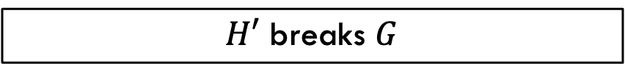
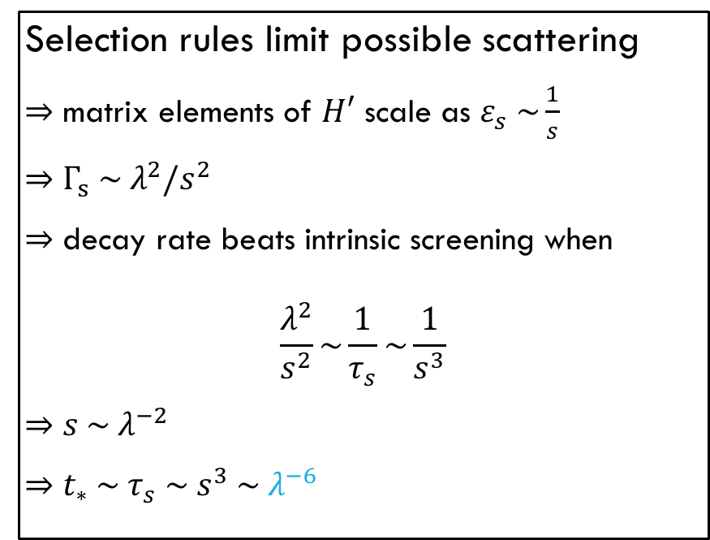
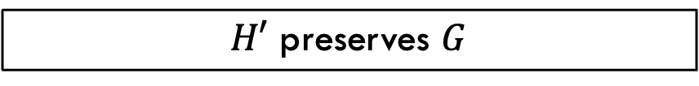
Breaking integrability
$H′$ breaks $G$
$H′$ preserves $G$
Fermi’s golden rule:
$$Γ_{s} \sim λ^{2}⇒t_{∗} \sim λ^{−2}$$
Selection rules limit possible scattering
$⇒$ matrix elements of $H′$ scale as $ε_{s} \sim \frac{1}{s}$
$⇒$ $Γ_{s} \sim λ^{2}/s^{2}$
$⇒$ decay rate beats intrinsic screening when
$$\frac{λ^{2}}{s^{2}}\sim \frac{1}{τ_{s}}\sim \frac{1}{s^{3}}$$
$⇒$ $s \sim λ^{−2}$
$⇒$ $t_{∗} \sim τ_{s} \sim s^{3} \sim λ^{−6}$
McCarthy et al., PRB (2024)

Slide 17
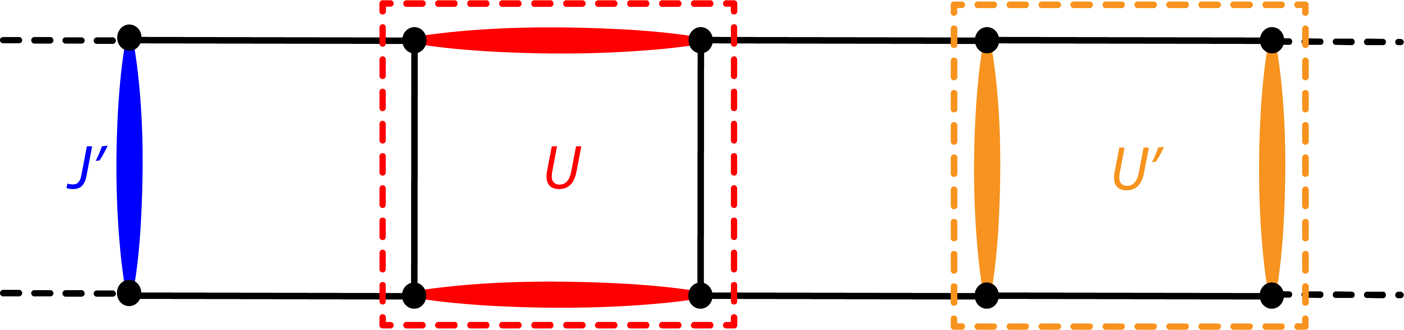
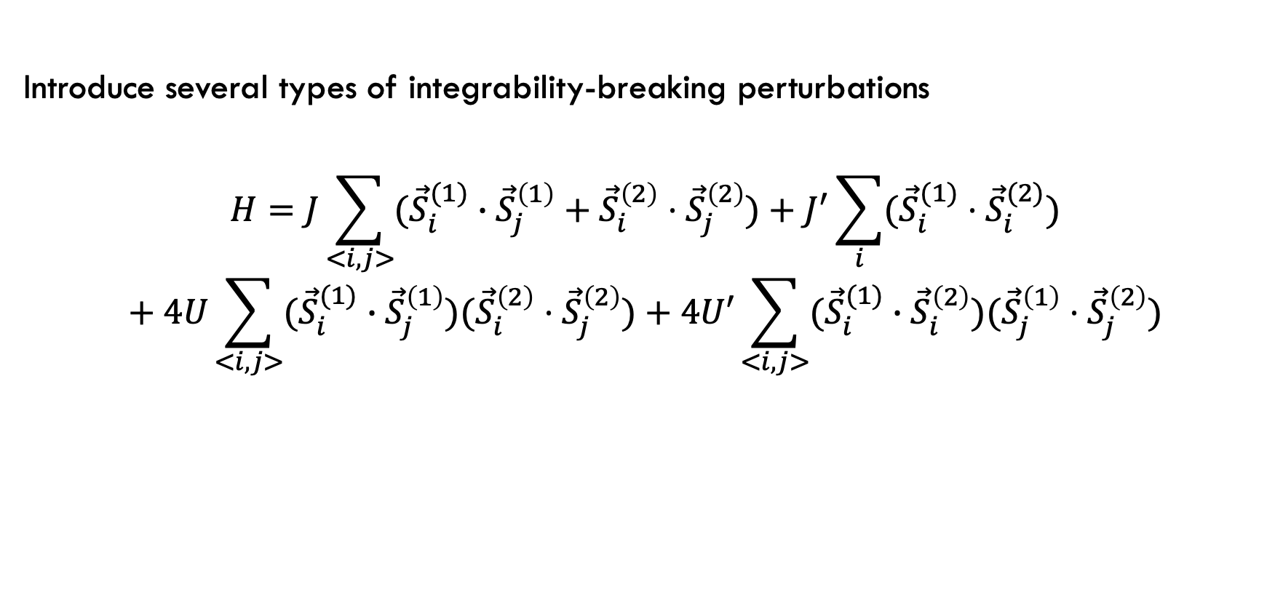
Heisenberg ladder
Introduce several types of integrability-breaking perturbations
$$H=J\sum_{<i,j>}{({\vec{S}}_{i}^{(1)}}∙{\vec{S}}_{j}^{\left(1\right)}+{\vec{S}}_{i}^{\left(2\right)}⋅{\vec{S}}_{j}^{\left(2\right)})+J^{′}\sum_{i}{({\vec{S}}_{i}^{(1)}⋅{\vec{S}}_{i}^{(2)})}$$
$$+ 4U\sum_{<i,j>}{({\vec{S}}_{i}^{(1)}}∙{\vec{S}}_{j}^{\left(1\right)})({\vec{S}}_{i}^{\left(2\right)}⋅{\vec{S}}_{j}^{\left(2\right)})+4U′\sum_{<i,j>}{({\vec{S}}_{i}^{(1)}}∙{\vec{S}}_{i}^{\left(2\right)})({\vec{S}}_{j}^{\left(1\right)}⋅{\vec{S}}_{j}^{\left(2\right)})$$

Slide 18

Heisenberg ladder
Consider two integrable points to perturb around:
$J^{′}=U=U^{′}=0$
$$H_{0}=J\sum_{<i,j>}{({\vec{S}}_{i}^{(1)}}∙{\vec{S}}_{j}^{\left(1\right)}+{\vec{S}}_{i}^{\left(2\right)}⋅{\vec{S}}_{j}^{\left(2\right)})$$
$$G=SU\left(2\right) × SU(2)$$

Slide 19
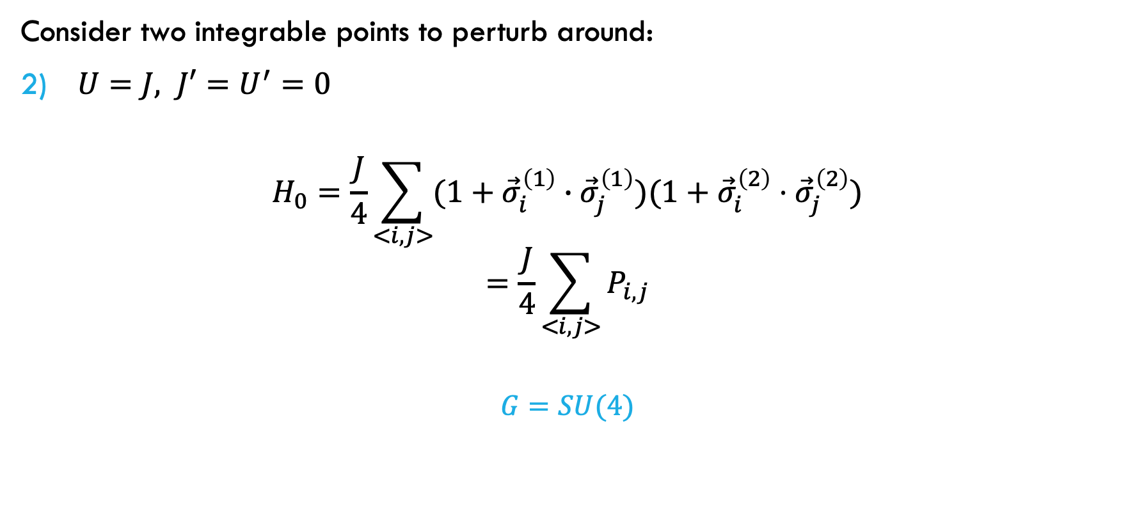
Heisenberg ladder
Consider two integrable points to perturb around:
$U=J, J′=U^{′}=0$
$$H_{0}=\frac{J}{4}\sum_{<i,j>}{(1+{\vec{σ}}_{i}^{\left(1\right)}}∙{\vec{σ}}_{j}^{\left(1\right)})(1+{\vec{σ}}_{i}^{\left(2\right)}⋅{\vec{σ}}_{j}^{\left(2\right)})$$
$$=\frac{J}{4}\sum_{<i,j>}{P_{i,j}}$$
$$G=SU(4)$$

Slide 20
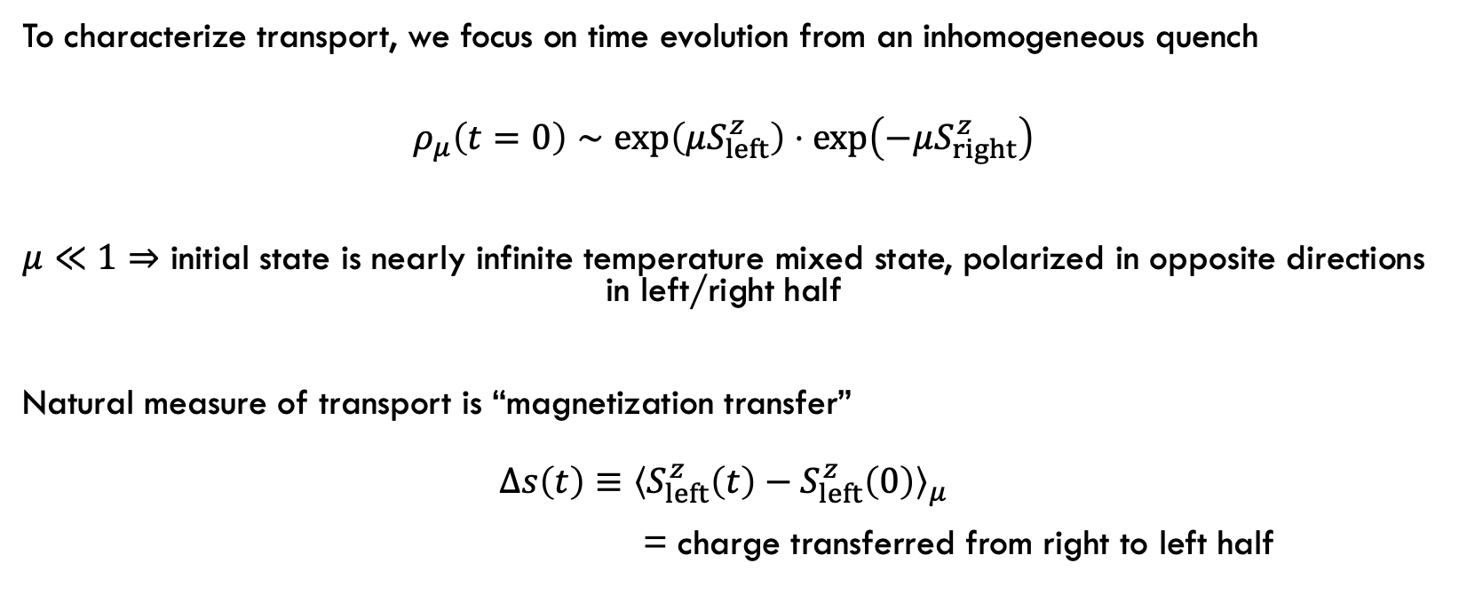
Spin Transport
To characterize transport, we focus on time evolution from an inhomogeneous quench
$$ρ_{μ}\left(t=0\right)∼\exp\left(μS_{left}^{z}\right)⋅\exp\left(−μS_{right}^{z}\right)$$
$μ≪1⇒$ initial state is nearly infinite temperature mixed state, polarized in opposite directions in left/right half
Natural measure of transport is “magnetization transfer”
$$Δs\left(t\right)≡{\left\langle S_{left}^{z}\left(t\right)−S_{left}^{z}\left(0\right)\right\rangle }_{μ}$$
= charge transferred from right to left half

Slide 21
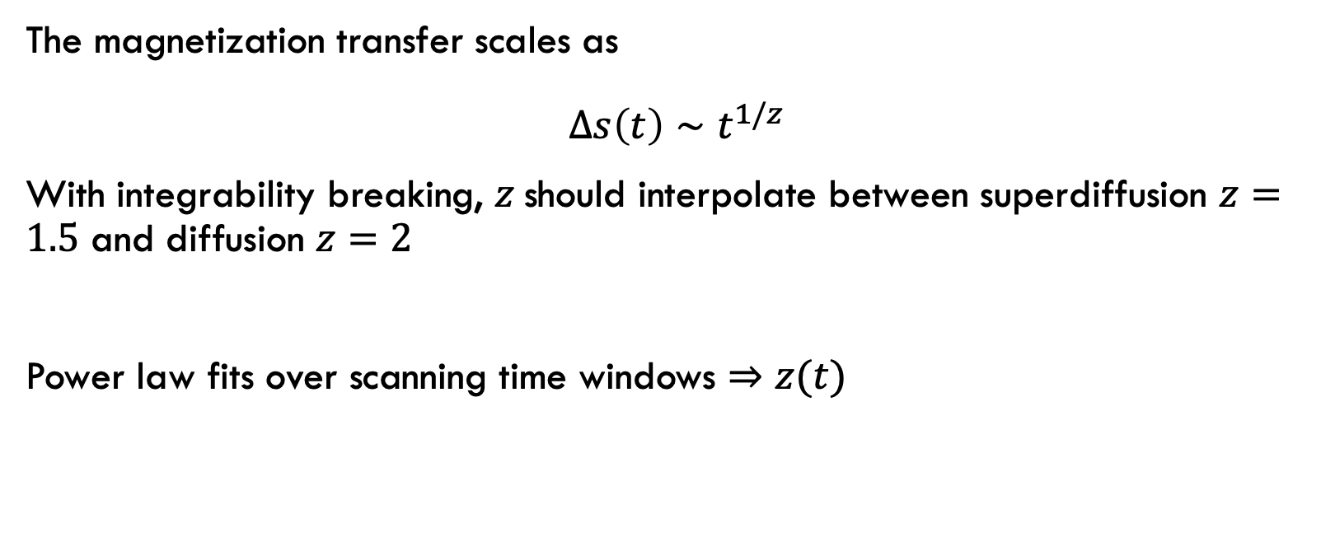
Spin Transport
The magnetization transfer scales as
$$Δs\left(t\right)∼t^{1/z}$$
With integrability breaking, $z$should interpolate between superdiffusion $z=1.5$ and diffusion $z=2$
Power law fits over scanning time windows $⇒$ $z(t)$

Slide 22


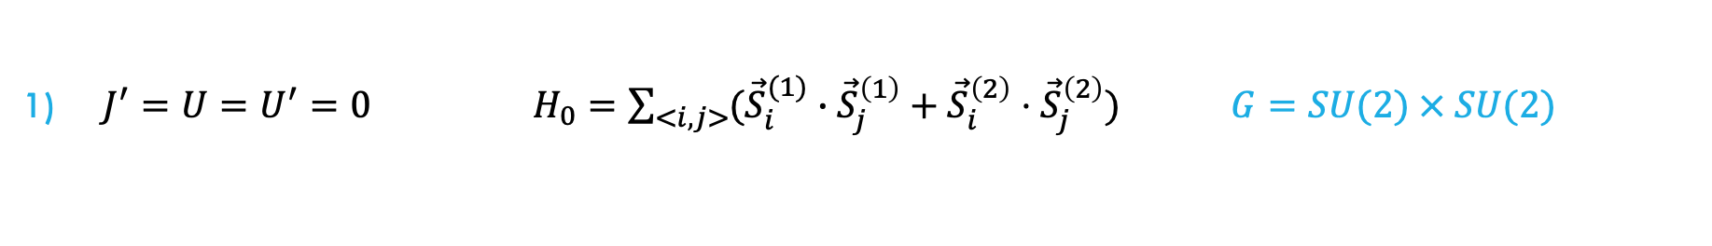

Spin Transport
$J^{′}=U=U^{′}=0 H_{0}=\sum_{<i,j>}{({\vec{S}}_{i}^{(1)}}∙{\vec{S}}_{j}^{\left(1\right)}+{\vec{S}}_{i}^{\left(2\right)}⋅{\vec{S}}_{j}^{\left(2\right)}) G=SU(2) × SU(2)$
$G$-breaking
$G$-breaking
$G$-invariant

Slide 23
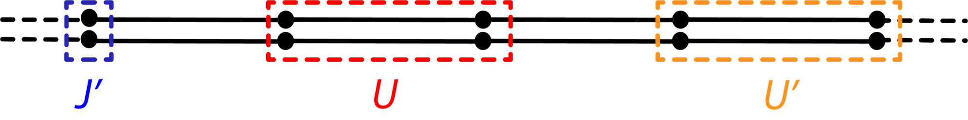
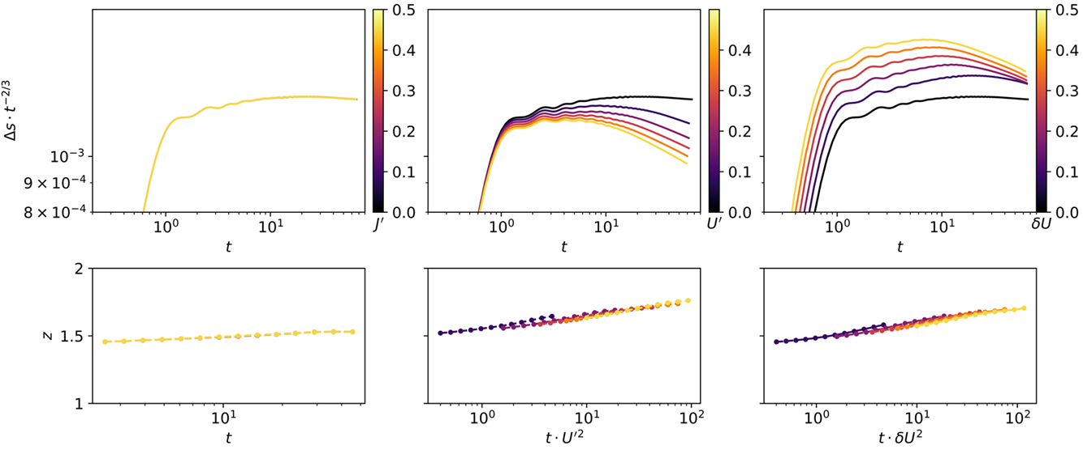


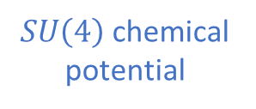
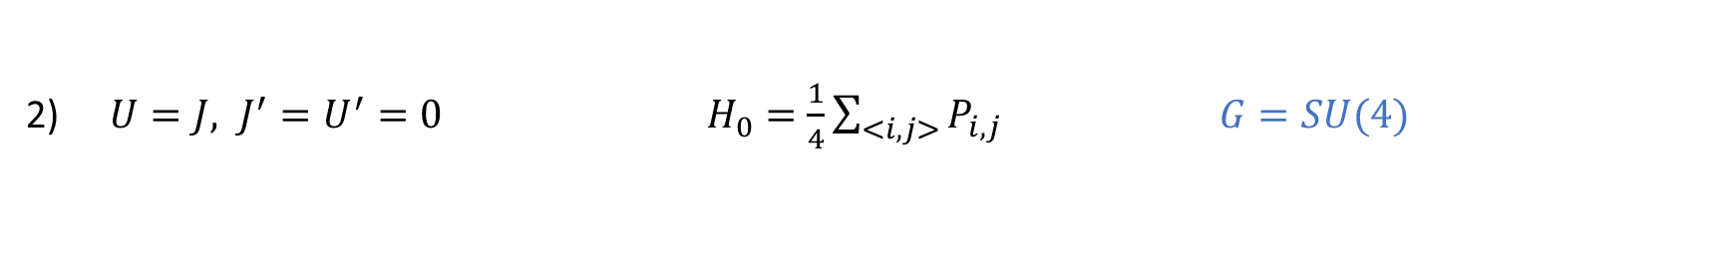
Spin Transport
$U=J, J^{′}=U^{′}=0 { H}_{0}=\frac{1}{4}\sum_{<i,j>}{P_{i,j}}$ $G=SU(4)$
$SU\left(4\right)$chemical potential
$G$-breaking
$G$-breaking

Slide 24

Superuniversal 𝐺-invariant behavior?
Simple non-abelian Lie group $G$ of rank $r⇒$quasiparticle flavor index $a=1,…,r$
Turns out that scaling of TBA quantities is universal
$v_{a,s} \sim 1/s$
$ρ_{a,s} \sim 1/s^{3}$
$τ_{a,s} \sim s^{3}$
$ε_{a,s} \sim 1/s$
So, same argument for $t_{∗} \sim λ^{−6}$ should still hold in principle

Slide 25
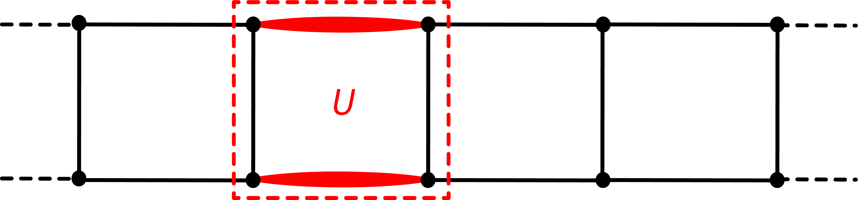
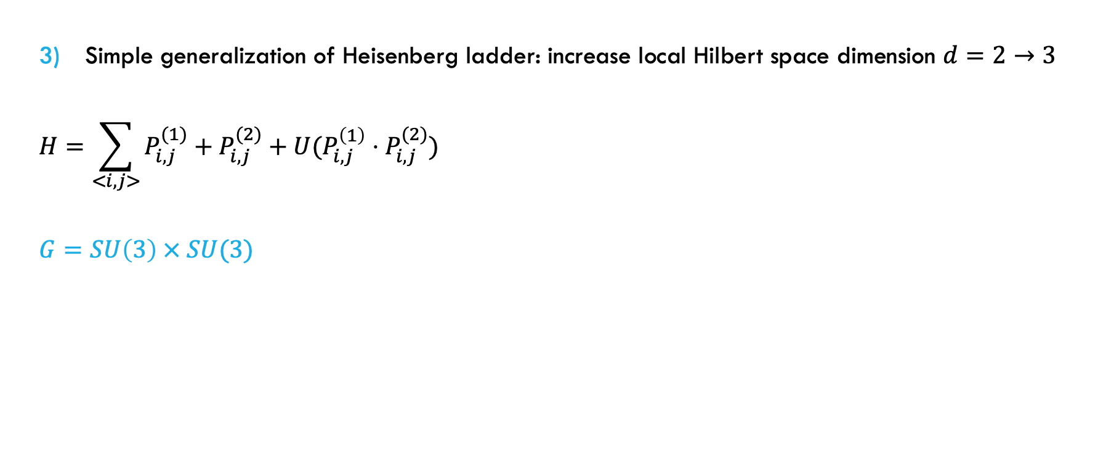
Spin Transport
Simple generalization of Heisenberg ladder: increase local Hilbert space dimension $d=2→3$
$$H=\sum_{<i,j>}{P_{i,j}^{(1)}+P_{i,j}^{(2)}+U(P_{i,j}^{\left(1\right)}⋅P_{i,j}^{(2)})}$$
$$G=SU\left(3\right) × SU(3)$$

Slide 26
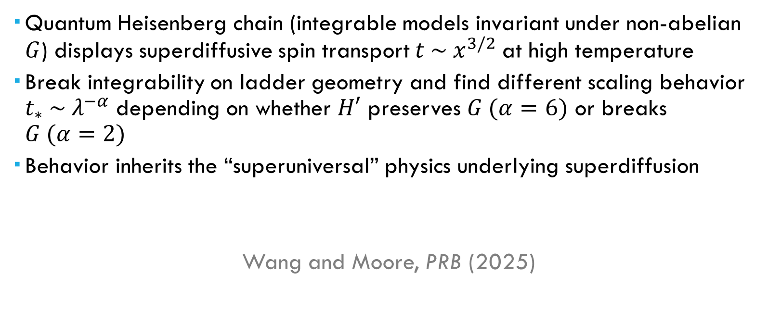
Summary
Quantum Heisenberg chain (integrable models invariant under non-abelian $G$) displays superdiffusive spin transport $t \sim x^{3/2}$at high temperature
Break integrability on ladder geometry and find different scaling behavior $t_{∗} \sim λ^{−α}$ depending on whether $H′$ preserves $G (α=6)$ or breaks $G (α=2)$
Behavior inherits the “superuniversal” physics underlying superdiffusion
Wang and Moore, PRB (2025)

Slide 27
Future Directions
Materials Synthesis: S=1/2 spin chains in nanoribbons
Topological graphene nanoribbons (Cao, Zhao & Louie, PRL (2017)
Rizzo, …, Louie, Crommie & Fischer, Nature (2018))
Edge theory of zigzag nanoribbons (Koop & Schmidt, PRB (2014))
Nanographene Olympicene chains (Zhao et al., Nat. Mater. (2025))
Molecular chains (Sun et al., Science Advances (2025))
Synthesize effective Heisenberg ladders with tunable interactions?

Slide 28
Quantum Heisenberg Model
Part I: Breakdown of superdiffusion in S=1/2 Heisenberg spin ladders and more…
Part II: Quantum spin liquid phase in J1-J2 model on triangular lattice

Slide 29
Quantum Heisenberg Model
Part I: Breakdown of superdiffusion in S=1/2 Heisenberg spin ladders and more…
Part II: Quantum spin liquid phase in J1-J2 model on triangular lattice

Slide 30
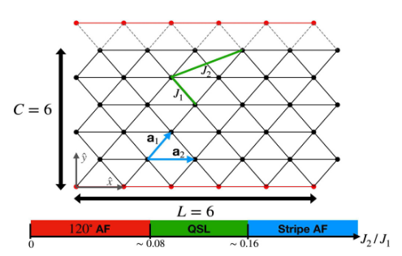
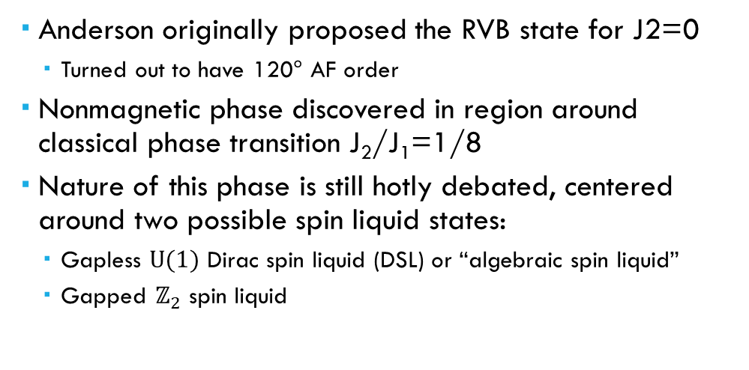
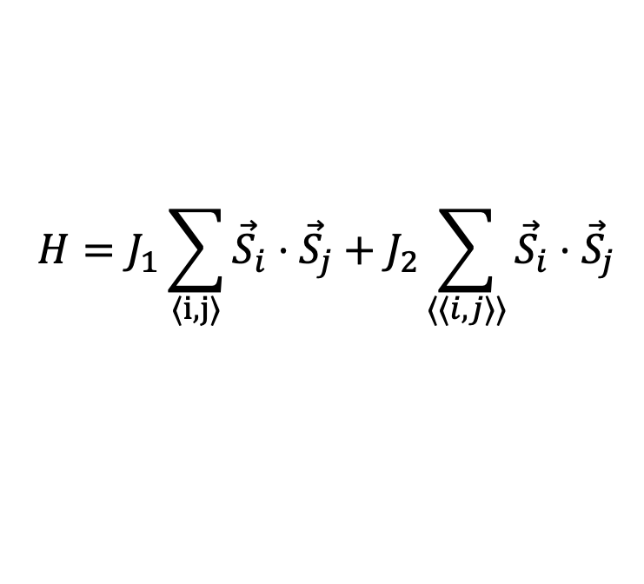
J₁-J₂ model on triangular lattice
$$H=J_{1}\sum_{〈i,j〉}{{\vec{S}}_{i}}⋅{\vec{S}}_{j}+J_{2}\sum_{〈〈i,j〉〉}{{\vec{S}}_{i}}⋅{\vec{S}}_{j}$$
Anderson originally proposed the RVB state for J2=0
Turned out to have 120$°$ AF order
Nonmagnetic phase discovered in region around classical phase transition J₂/J₁=1/8
Nature of this phase is still hotly debated, centered around two possible spin liquid states:
Gapless $U(1)$ Dirac spin liquid (DSL) or “algebraic spin liquid”
Gapped $ℤ_{2}$ spin liquid
Sherman, Dupont, and Moore, PRB (2023)

Slide 31


Theory of quantum spin liquids
Parton methods:
Write spin Hilbert space in enlarged fermionic/bosonic representation
Physical Hilbert space recovered by imposing single-occupancy constraint
Spin liquid = low-energy matter-gauge theory with deconfined “spinons” carrying fractionalized spin S=1/2
Schwinger bosons
$${\vec{S}}_{i}=\frac{1}{2}b_{iα}^{†}{\vec{σ}}_{αβ}b_{iβ}$$
$$\sum_{α}{b_{iα}^{†}b_{iα}}=1$$
Abrikosov fermions
$${\vec{S}}_{i}=\frac{1}{2}f_{iα}^{†}{\vec{σ}}_{αβ}f_{iβ}$$
$$\sum_{α}{f_{iα}^{†}f_{iα}}=1$$

Slide 32

Theory of quantum spin liquids
Parton methods:
Write spin Hilbert space in enlarged fermionic/bosonic representation
Physical Hilbert space recovered by imposing single-occupancy constraint
Spin liquid = low-energy matter-gauge theory with deconfined “spinons” carrying fractionalized spin S=1/2
Schwinger bosons
$${\vec{S}}_{i}=\frac{1}{2}b_{iα}^{†}{\vec{σ}}_{αβ}b_{iβ}$$
$$\sum_{α}{b_{iα}^{†}b_{iα}}=1$$
Abrikosov fermions
$${\vec{S}}_{i}=\frac{1}{2}f_{iα}^{†}{\vec{σ}}_{αβ}f_{iβ}$$
$$\sum_{α}{f_{iα}^{†}f_{iα}}=1$$

Slide 33


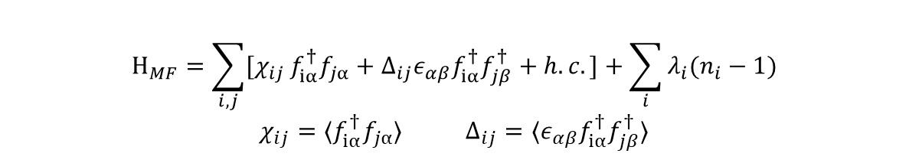
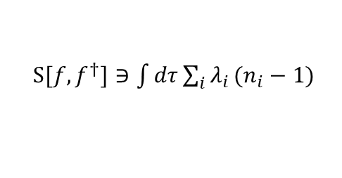
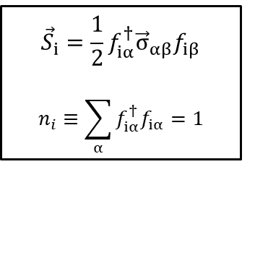
Theory of quantum spin liquids
$${\vec{S}}_{i}=\frac{1}{2}f_{iα}^{†}{\vec{σ}}_{αβ}f_{iβ}$$
$$n_{i}≡\sum_{α}{f_{iα}^{†}f_{iα}}=1$$
Recipe for mean-field theory:
Rewrite Heisenberg interaction using fermionic operators
Write down path integral with Lagrange multiplier term enforcing single occupancy
Decouple quartic terms using Hubbard-Stratonovich transformation in hopping and pairing channels
Saddle point approximation leads to mean-field Hamiltonian for spinons (partons)
Different patterns of $χ_{ij},Δ_{ij}$ amount to different MF ansatze, with ground state ${|Ψ_{MF}(χ}_{ij},Δ_{ij})⟩$
Obtain physical wavefunction by (Gutzwiller) projecting to original Hilbert space
$S[f,f^{†}]∋\int{dτ}\sum_{i}{λ_{i}}(n_{i}−1)$
$$H_{MF}=\sum_{i,j}{[χ_{ij}}f_{iα}^{†}f_{jα}+Δ_{ij}ε_{αβ}f_{iα}^{†}f_{jβ}^{†}+h.c.]+\sum_{i}{λ_{i}(n_{i}−1)}$$
${χ_{ij}=⟨f}_{iα}^{†}f_{jα}⟩$ ${Δ_{ij}=⟨ε}_{αβ}f_{iα}^{†}f_{jβ}^{†}⟩$
$P_{G}≡\prod_{i}{(1−n_{i↑}n_{i↓})}$ $\left|Ψ_{phys}\right\rangle =P_{G}|Ψ_{MF}⟩$

Slide 34
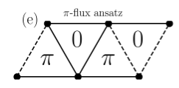
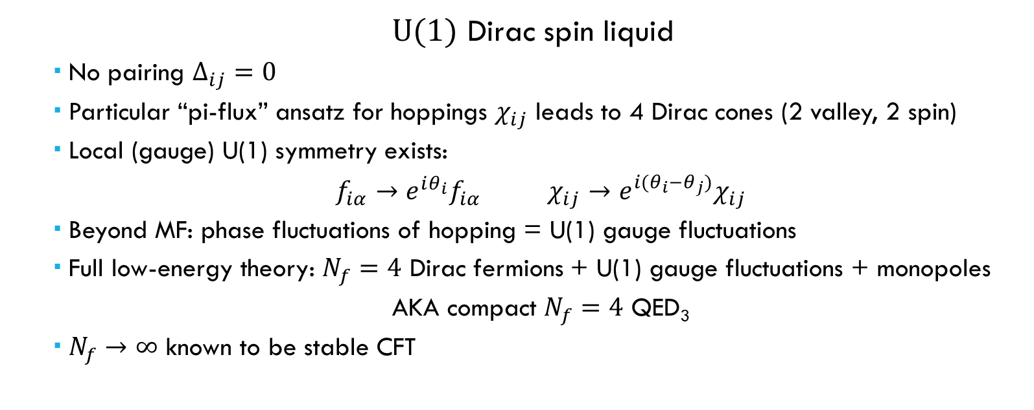
Theory of quantum spin liquids
$$H_{MF}=\sum_{i,j}{[χ_{ij}}f_{iα}^{†}f_{jα}+h.c.]+\sum_{i}{λ_{i}(n_{i}−1)}$$
Wietek et al., PRX (2024)
$U(1)$ Dirac spin liquid
No pairing $Δ_{ij}=0$
Particular “pi-flux” ansatz for hoppings $χ_{ij}$ leads to 4 Dirac cones (2 valley, 2 spin)
Local (gauge) U(1) symmetry exists:
$f_{iα}→e^{iθ_{i}}f_{iα}$ $χ_{ij}→e^{i(θ_{i}−θ_{j})}χ_{ij}$
Beyond MF: phase fluctuations of hopping = U(1) gauge fluctuations
Full low-energy theory: $N_{f}=4$ Dirac fermions + U(1) gauge fluctuations + monopoles
AKA compact $N_{f}=4$ QED₃
$N_{f}→∞$ known to be stable CFT

Slide 35

Theory of quantum spin liquids
$$H_{MF}=\sum_{i,j}{[χ_{ij}}f_{iα}^{†}f_{jα}+Δ_{ij}ε_{αβ}f_{iα}^{†}f_{jβ}^{†}+h.c.]+\sum_{i}{λ_{i}(n_{i}−1)}$$
Gapped $ℤ_{2}$ spin liquid
Both $χ_{ij}≠0$ and $Δ_{ij}≠0$
Local symmetry “Higgsed” down to $ℤ_{2}$
$f_{iα}→s_{i}f_{iα}$ $χ_{ij}→s_{i}s_{j}χ_{ij}$ $s_{i}=±1$
Particular MF ansatze give gapped spinon spectrum
Integrating out spinons leaves pure gauge theory with $ℤ_{2}$ topological order (~ toric code)
Topological ground state degeneracy
$e,m,ε$ anyonic excitations with mutual “semionic” statistics

Slide 36



Numerical evidence
$U(1)$ Dirac spin liquid
Kaneko, Morita, and Imada (2014, VMC)
Bishop and Li (2015, CCM)
Iqbal, Hu, Thomale, Poilblanc, and Becca (2016, VMC)
Hu, Zhu, Eggert, and He (2019, flux-insertion DMRG)
Ferrari and Becca (2019, dynamical VMC)
Sherman, Dupont, and Moore (2023, MPS dynamics)
Drescher, Vanderstraeten, Moessner, and Pollmann (2023, MPS dynamics)
Wietek, Capponi, and Lauchli (2024, ED)
Gapped $ℤ_{2}$ spin liquid
Zhu and White (2015, DMRG)
Hu, Gong, Zhu, and Sheng (2015, DMRG)
Saadatmand and McCulloch (2016, DMRG)
Jiang and Jiang (2023, DMRG)
Competing quasi-degenerate sectors
Kovalska et al. (2026, MPS + TaSK) NOT gapped $ℤ_{2}$
Jiang, White, Kivelson, and Jiang (2026, dynamical DMRG)

Slide 37

Dynamical correlations
Can use DMRG + time evolution to directly access magnetic Van Hove correlations in spacetime
$$G\left(x,t\right)=⟨Ω|S_{x}\left(t\right)⋅S_{0}\left(0\right)|Ω⟩$$
Fourier transform gives spectral function, proportional to inelastic neutron scattering (INS) cross section
$$S\left(k,ω\right)∼∫dt\sum_{x}{e^{i\left(ωt−k⋅x\right)}G(x,t)}$$

Slide 38


Material platforms
KYbSe₂
J₂/J₁=0.044(5)
Sits in 120$°$ ordered phase near quantum critical point (QCP)
T_{N} = 290mK
Physics above T_{N} described by quantum critical fan of QCP
Scheie et al., arxiv:2602.02433

Slide 39



Material platforms
YbZn₂GaO₅
J₂/J₁=0.12, XXZ anisotropy $Δ$=1.35
Bag et al., PRL (2024)

Slide 40

Material platforms
YbZn₂GaO₅
J₂/J₁=0.12, XXZ anisotropy $Δ$=1.35

Slide 41

Future Directions
Gutzwiller MPS:
Can efficiently prepare MF ansatz as an MPS, i.e. $\left|Ψ_{phys}\right\rangle =P_{G}|Ψ_{MF}⟩$ (Jin et al., AAPPS Bulletin (2025))
Ideas: Prepare various ansatz states and…
Look at overlap with DMRG ground state $⟨Ω|Ψ_{phys}⟩$
Use as DMRG initialization to see if lower energy is reached
Dynamical correlations $G\left(x,t\right)=⟨Ψ_{phys}|S_{x}\left(t\right)⋅S_{0}\left(0\right)|Ψ_{phys}⟩$
Prepare excitation states and time evolve $⇒$ spinon-spinon, monopole-monopole correlations, etc.

Slide 42


preliminary data

Slide 43

preliminary data

Slide 44

preliminary data

Slide 45




Thanks!
Joel Moore

Slide 46

Future Directions
Energy transport (${ J}_{E}$) measurements
Unlike spin transport, the energy current in the Heisenberg chain is explicitly conserved (ballistic transport)
Resonant Inelastic X-ray Scattering (RIXS) can probe energy correlations (Kumar et al. PRB ‘22)
Possible to observe signatures of ballistic transport in RIXS data for quasi-1D Heisenberg chains?

Slide 47

Spin Transport
$J^{′}=U=U^{′}=0 H_{0}=\sum_{<i,j>}{({\vec{S}}_{i}^{(1)}}∙{\vec{S}}_{j}^{\left(1\right)}+{\vec{S}}_{i}^{\left(2\right)}⋅{\vec{S}}_{j}^{\left(2\right)}) G=SU(2) × SU(2)$

Slide 48


Spin Transport
$J^{′}=U=U^{′}=0 H_{0}=\sum_{<i,j>}{({\vec{S}}_{i}^{(1)}}∙{\vec{S}}_{j}^{\left(1\right)}+{\vec{S}}_{i}^{\left(2\right)}⋅{\vec{S}}_{j}^{\left(2\right)}) G=SU(2) × SU(2)$

Slide 49

Spin Transport
$J^{′}=U=U^{′}=0 H_{0}=\sum_{<i,j>}{({\vec{S}}_{i}^{(1)}}∙{\vec{S}}_{j}^{\left(1\right)}+{\vec{S}}_{i}^{\left(2\right)}⋅{\vec{S}}_{j}^{\left(2\right)}) G=SU(2) × SU(2)$

